Slide 1
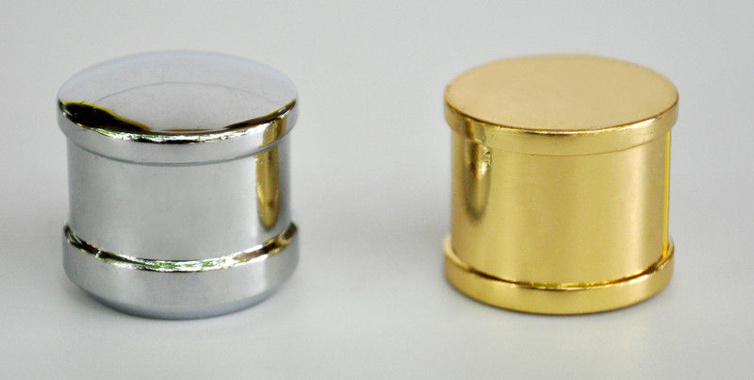
Metals alloys
GILBERTO CORTES RETANA
1757150

Slide 2
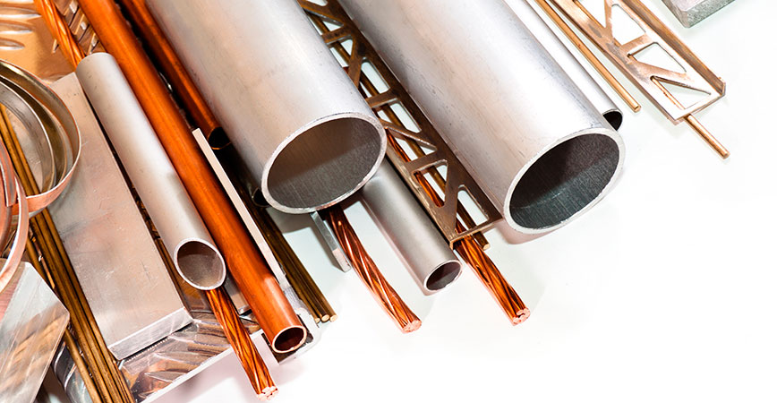
Pure metals generally do not have all the characteristics necessary to be applied in the manufacture of the products used by society. Therefore, metal alloys arose, which are mixtures of two or more metals or a metal with another simple substance by means of heating

Slide 3
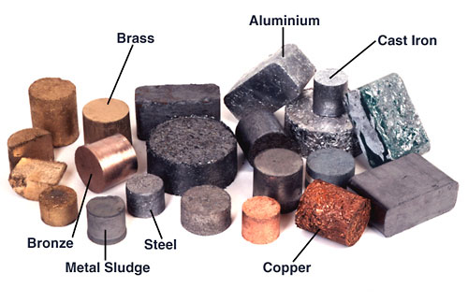
These components melt at high temperature and then cool, solidifying. The metals are melted to produce the metallic alloy. The resulting properties that will be useful for each specific application will be determined by the metals to be used, the amount of each metal in the alloy, by the structure of the crystalline organization of the alloys, by the size and arrangement of the crystals and by the additional treatments that can be done

Slide 4
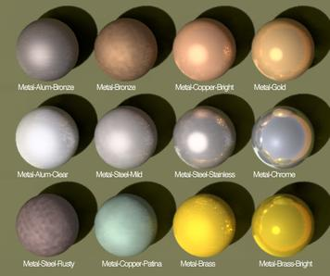
Stainless steel: made up of 74% steel, 18% chromium and 8% nickel. Because it is practically stainless, it is used in auto parts workshops, drill bits, kitchen utensils and decoration. 18 carat gold: alloy consisting of 75% gold, 13% silver and 12% copper. Its advantage in relation to pure gold is that this metal is soft and can be easily scratched. In addition, the alloy maintains the desired properties of gold, such as brightness, proper hardness for the jewel and durability. Bronze: formed by 67% copper and 33% tin. Its main characteristic is its resistance to wear, being widely used to produce bells, statues, coins and medals. Brass: mixture of 95 to 55% copper and 45 to 5% zinc. Due to its high flexibility, it is used to produce wind musical instruments such as flute, saxophone, trumpet, etc., but it can also be applied to machinery parts, production of pipes, taps and weapons. Amalgam: widely used in tooth fillings, the amalgam is formed by the mixture of 70% silver, 18% tin, 10% copper and 2% mercury.

Slide 5
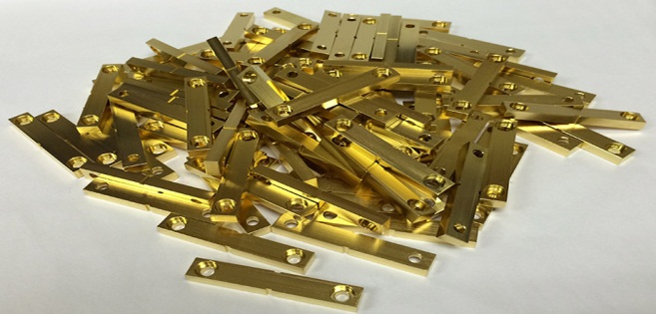
It is very resistant to oxidation (corrosion), is very malleable and can be molded into the patient's tooth. Wood's metal: formed by 50% bismuth, 25% lead, 12.5% ​​tin and 12.5% ​​cadmium. Its main characteristic is the low melting temperature (around 68 ºC). This property is important because, thanks to it, this connection can be used in electrical fuses, being that when the intensity of the electric current is very high, the temperature increases and the fuse melts, interrupting the passage of electric current and preventing that the electrical equipment is burned. Wood's Metal is used mainly in showers and electric irons.

Slide 6
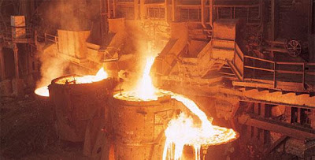
Alloys
Alloy is the process by which two or more elements, usually metallic, are combined into a single unit that gains the properties of both. Alloys are mostly considered mixtures, since the atoms of the combined components do not produce, except on rare occasions, chemical reactions that intertwine their atoms.
Normally, the substances used in alloys are metallic: iron, aluminum, copper, lead, etc., but a metallic element can also be combined with a non-metallic

Slide 7
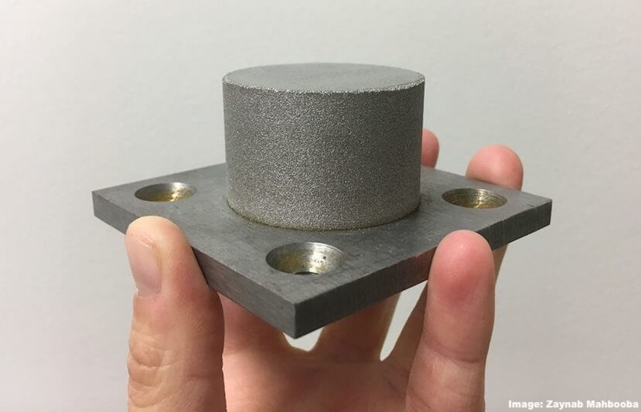
Types of alloys
A distinction is usually made between alloys based on the predominance of one element over the others (for example, copper alloys), but they are also classified according to the number of elements involved in the mixture, namely:
Binary They consist of two elements (the base element and the alloy).
Ternary. They consist of three elements (the base element and two alloying elements).
Quaternary They consist of four elements (the base element and three alloying elements).
Complex They consist of five or more elements (the base element and four or more alloying elements).
Another possible classification distinguishes between heavy and light alloys, according to the properties of the metallic base substance. Thus, the alloys of aluminum will be light, but those of iron will be heavy.

Slide 8
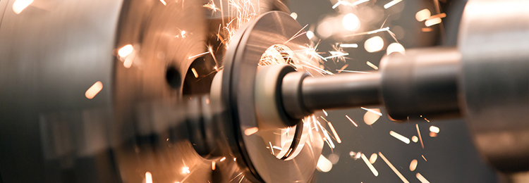
Steel. This alloy is fundamental for the construction industry, since with it the beams or supports for the pouring of concrete or concrete are made
Brass. This material is widely used in the container industry, especially those destined for non-perishable food, as well as domestic plumbing and plumbing.
Bronze. The bronze played a very important role in the history of humanity, as a material to make tools, weapons and ceremonial objects.
Stainless steel. This variant of ordinary steel (carbon steel) is highly prized for its extreme resistance to corrosion, which makes it ideal for manufacturing kitchenware, auto parts and medical tools.

Slide 9
Amalgam. In frank disuse due to its mercury content that makes it slightly toxic to the human body, this metallic filling used to be used as dental sealant by dentists.
Duraluminium Duralumin is a light and resistant metal, which combines the properties of copper and aluminum, whose alloy is a product.
Pewter. Product of the zinc, lead, tin and antimony alloy, it is a substance long used in the elaboration of kitchen objects (cups, plates, pots, etc.) due to its extreme lightness and heat conduction
White gold. Many gems (rings, necklaces, etc.) and ornamental objects are made from the so-called white gold: a very shiny, shiny and precious metal that is obtained from alloying gold, copper, nickel and zinc.
Magnalio. Another metal highly demanded by the automotive and canned industries, since despite its low density it has hardness, toughness and tensile strength. It is obtained by alloying aluminum with a magnesium content (only 10%)
Metal by Wood. This metal got its name from dentist Barnabas Wood, its inventor, and it is an alloy of 50% bismuth, 25% lead, 12.5% ​​tin and 12.5% ​​cadmium.

Slide 10
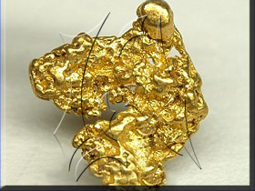
Field metal. This alloy of bismuth (32.5%), indium (51%) and tin (16.5%) becomes liquid at 60 ° C, so it is used for industrial molding and prototyping, or as a non-toxic replacement of Wood's metal.
Galinstano. One of the metals with which it has been tried to replace the uses of alloys with mercury (toxic), is this alloy of gallium, indium and tin.

